Slide 1
Civil Law and Criminal Law
Major Differences Between Civil and Criminal Law.
Burden of Proof. Civil is preponderance of the evidence. Criminal is proof beyond a reasonable doubt.
Criminal Sanctions. Harsher penalties than those applied in civil cases.

Slide 2
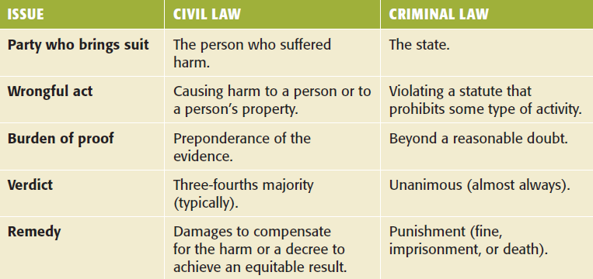
Key Differences

Slide 3
Civil Law and Criminal Law
Civil Liability for Criminal Acts.
Assault and Battery can provide basis for both a civil lawsuit and a criminal prosecution. →

Slide 4
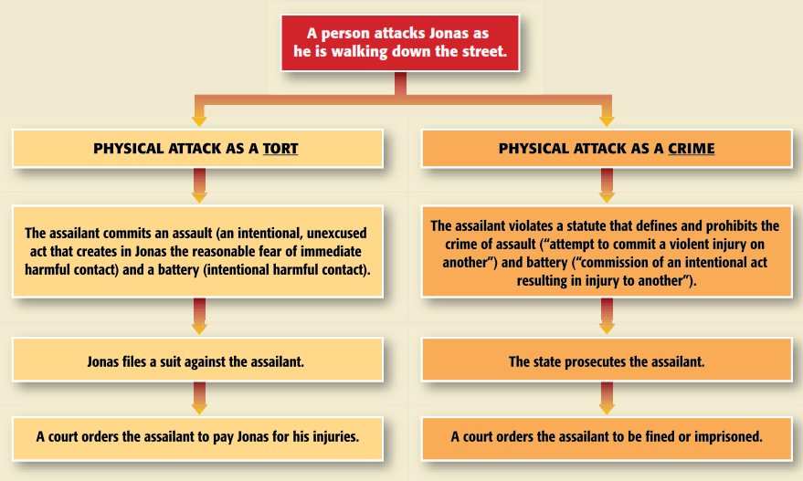
Ex. Tort Lawsuit and Criminal Prosecution for Same Act :pg.171 text

Slide 5
Criminal Liability
To be convicted of a crime, a person:
Must commit a criminal act (actus reus).
Additionally often have a second element of the guilty mind (mens rea) during commission of the guilty act. →

Slide 6
Business Crime Elements
Actus Reus—The Act of the Crime
Intent alone is not a crime; the act must be committed
The required conduct described for each crime
Sometimes a failure to act may constitute a crime—for example, failure to pay taxes

Slide 7
Criminal Liability
State of Mind.
Required intent (or mental state) is indicated in the applicable statute.
Criminal Negligence or Recklessness (unjustified, substantial and foreseeable risk that results in harm). →

Slide 8
Business Crime Elements
Criminal Intent—Scienter or Mens Rea
State of mind required to commit a crime
For corporations—prove intention on behalf of directors
To prosecute, must show individual intent
Can establish by showing their knowledge of actions and failure to object

Slide 9
Criminal Liability
State of Mind: Strict Liability and Overcriminalization.
Federal code lists over 4,000 criminal offenses, many do not list a “mental state” for conviction.
Strict liability crimes are found in environmental, drug laws that affect public health, safety, and welfare.

Slide 10
What is Business Crime?
Corporate Crime, Also Called ‘White Collar Crime’, Occurs Because of Economic Pressure on Managers and Employees for Results
VW Executives diesel scandal
Jeffrey Skilling CEO of Enron, and Andrew Fastow, CFO, Charged With Federal Securities Fraud

Slide 11
What is Business Crime?
Intra-Business Crime (90%)
Stealing from employers
High cost of insurance and security
Includes thefts and kickbacks
Inter-Business Crime
Stealing from competitors
Acting illegally to gain a competitive advantage
Electronic eavesdropping
Federal violations—securities, campaign laws, antitrust

Slide 12
Criminal Liability
Corporate Criminal Liability.
A corporation itself cannot be imprisoned but can be convicted of crime through acts of its officers/employees.
Liability of the Corporate Entity.
If crime is within agent/employee’s scope of employment; →

Slide 13
Criminal Liability
Corporate Criminal Liability.
Liability of the Corporate Entity.
Corporation fails to perform a legally required duty; or
Crime authorized or requested by corporate principal/officer.

Slide 14
Criminal Liability
Corporate Criminal Liability.
Liability of Corporate Officers and Directors.
Corporate officers and directors are personally liable for crimes they commit.
They may be criminally liable for acts under the “Responsible Corporate Officer” doctrine.

Slide 15
Liability for Crimes
Officers and Directors are Liable
If they authorized the conduct, or
If they knew about the conduct and did nothing or insufficient action:
United States v. Park (1975)

Slide 16
Penalties for Business Crime
ACT
Internal Revenue Code
26 U.S.C. 7201
Sherman Act (antitrust)
15 U.S.C. 1
Sarbanes-Oxley
15 U.S.C. §1512
(document destruction, concealment, alteration, mutilation during pending civil or criminal investigation)
PENALTIES
$100,000 ($500,000 for corporations) and/or 5 years
For evasion (plus costs of prosecution as well as penalties and assessments: 5-50%)
$350,000 and/or 3 years
$10,000,000 for corporations
Injunctions
Divestiture
20 years plus fines

Slide 17
Penalties for Business Crime
Sarbanes-Oxley
(certification of financial statements)
1933 Securities Act
15 U.S.C. 77x (as amended by Sarbanes-Oxley)
Securities and Exchange Act of 1934
15 U.S.C. 78ff
Clean Air Act
42 U.S.C. 7413
$1,000,000 and/or 10 years
If willful: $5,000,000 and 20 years
Officers who earn bonuses based on falsified financial statements must forfeit them
$100,000 and/or 10 years
$5,000,000 and/or 20 years
$25,000,000 for corporations
Civil penalties in addition of up to three times profit made or $1,000,000, whichever is greater
$1,000,000 and/or 5 years

Slide 18
Types of Crimes
Violent Crime.
Murder, sexual assault, rape, robbery.
Property Crime.
Burglary, larceny, theft of trade secrets, theft of services, arson, receipt of stolen goods, forgery.
Public Order Crime.
Gambling, prostitution.

Slide 19
Types of Crimes
White-Collar Crime.
Occur in a business context using non-violent means to obtain personal or business advantage.
Embezzlement.
Is the intent to return stolen property a defense?

Slide 20
Types of Crimes
White-Collar Crime.
Mail and Wire Fraud (federal).
Bribery.
Bankruptcy Fraud (federal).
Theft of Trade Secrets and Intellectual Property.
Insider Trading (federal).

Slide 21
Types of Crime
Organized Crime.
Operates illegitimately by providing illegal goods and services:
Money Laundering.
RICO: Government must prove a “pattern of racketeering activity” and defendant committed at least two offenses.

Slide 22
Types of Crimes
Classification of Crimes.
Felonies: punishable by death or imprisonment over 1 year.
Misdemeanors: punishable by fine or jail for less than 1 year. Petty offenses are minor violations such as jaywalking or violations of building codes.

Slide 23
Defenses to Criminal Liability
Justifiable Use of Force.
Self-Defense of People and Property can use deadly force if reasonable belief of imminent death or serious injury; cannot use deadly force to protect property alone.

Slide 24
Defenses to Criminal Liability
Necessity.
Criminal act necessary to prevent greater harm.
Insanity.
Person who suffers from mental illness may be incapable of the state of mind required for the crime. →

Slide 25
Defenses to Criminal Liability
Mistake: of fact may excuse crime.
Duress.
Wrongful threat induces another to perform a criminal act.
Entrapment.
Key issue: was the defendant pre-disposed to commit the act? →

Slide 26
Defenses to Criminal Liability
Statute of Limitations.
State must initiate criminal proceedings within statutory period of time (except for murder).
Immunity.
Government grants immunity from prosecution in exchange for assistance.

Slide 27
Constitutional Safeguards and Criminal Procedures
U.S. Constitution provides specific safeguards for those accused of crimes at federal and state level.
Criminal procedures are designed to protect against the arbitrary use of power by the government. →

Slide 28
Constitutional Safeguards and Criminal Procedures
Fourth Amendment Protections.
Protection from unreasonable searches and seizures.
Requirement search warrant for a search or an arrest must be issued only after finding probable cause. →

Slide 29
Constitutional Safeguards and Criminal Procedures
The Exclusionary Rule.
Evidence obtained in violation of the Fourth Amendment is excluded from trial, including “Fruit of the Poisonous Tree.”

Slide 30
Procedural Rights
Fifth Amendment Rights:
Protection against self-incrimination
Given to natural persons - not to corporations
Corporate officers can assert it to protect themselves but not corporate records

Slide 31
Constitutional Safeguards and Criminal Procedures
The Miranda Rule.
Miranda v. Arizona (1966) required police to inform suspects of their constitutional rights.
Exceptions to Miranda: public safety, certain confessions, suspect must unequivocally assert right to counsel.

Slide 32
Procedural Rights
Fifth Amendment Rights
Miranda warnings:
Given when individual is in “custody”
“Custody” means inability to leave—not necessarily jail
Right to attorney; right to silence—notice of evidentiary use of statements

Slide 33
Procedural Rights
Due Process Protections of Fifth Amendment
Warrant or warrantless arrest begins process
Warrant—you have committed crime and they look for you
Warrantless—you are arrested at the scene
Initial appearance
Required within short period (24 hours)
Charges explained
Bail terms set; amount; or released on own recognizance

Slide 34
Criminal Process
Arrest
Booking
Initial Appearance
Grand Jury
Preliminary Hearing
Indictment
Information
Arraignment
Plea Bargain
Guilty Plea
Trial

Slide 35
Criminal Process
Sentencing Guidelines.
Passed by Congress in 1984.
Shift Away from Mandatory Sentencing.
Increased Penalties for Certain Crimes.
The First Step Act 2018 for federal system easing punitive mandatory minimum
Earn credits for good behavior, elements of rehabilitation

Slide 36
Cyber Crime
Any act directed against computers or that uses computers as an instrumentality of a crime.
Cyber Fraud: fraud committed over the internet (e.g., Nigerian letter scam).
Online Auction Fraud.
Online Retail Fraud.

Slide 37
Computer Crime Laws
No Electronic Theft Act
Passed in 1997, this law outlaws the willful infringement of copyright material worth over $1,000
Economic Espionage Act
Outlaws stealing trade secrets in any way
Cyberbullying
Used to be prosecuted using other statutes; now a specific crime

Slide 38
Cyber Crime
Cyber Theft.
Identity Theft.
United States v. Oliver (2011). Why were the searches at the girlfriend’s home legal?
Phishing.
Vishing.

Slide 39
Cyber Crime
Cyber Theft.
Vishing.
Employment Fraud.
Credit-Card Crime on the Web.

Slide 40
Cyber Crime
Hacking.
Malware and Worms.
New Service-Based Hacking Available at Low Cost.
Cyber Terrorism.

Slide 41
Cyber Crime
Prosecution of Cyber Crime.
“Location” of crime is an issue.
Jurisdiction of courts is an issue.
Computer Fraud and Abuse Act.
Person is liable if he accesses a computer online, without authority, to obtain classified, private, or protected information.

